Slide 1

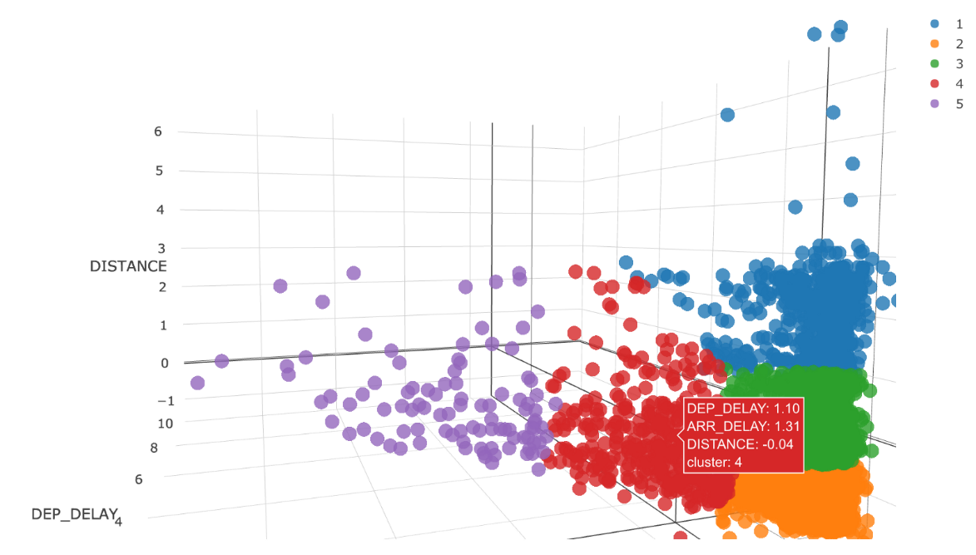
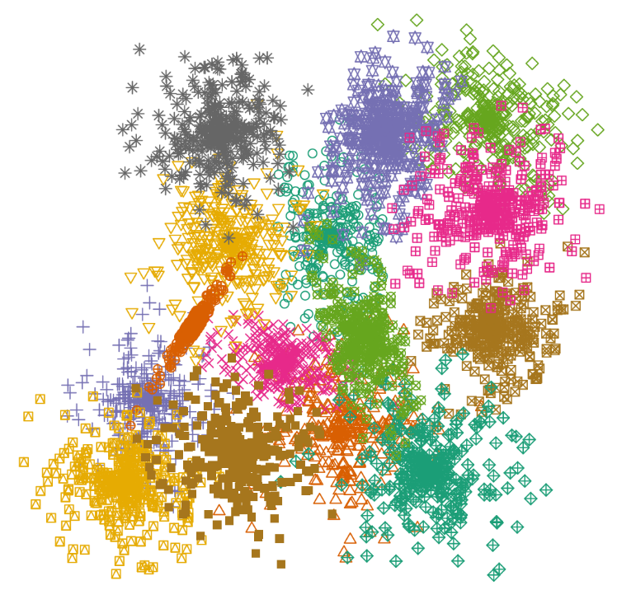

JA114 Data Clustering Some slides adapted from those by Bing Liu, UIC. Academic Year 2021-2022
John Abela
Department of CIS
Faculty of ICT
University of Malta
john.abela@um.edu.mt
+ 365 79367936
Room 1A/27
FICT Building
©John Abela 2017-2022
Faculty of
ICT
Department of
Computer Information Systems
Last Updated
17-Nov-2022

Slide 2
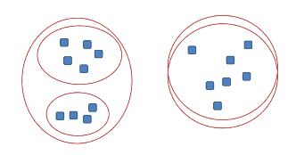
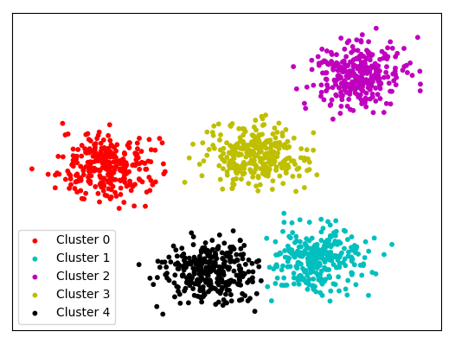

Roadmap
Data
Clustering
Basic Concepts
K-Means Algorithm
Representation of Clusters
Hierarchical Clustering
Distance Functions
Data Standardization
Handling Mixed Attributes
Which Clustering Algorithm to use?
Summary
ICT

Slide 3
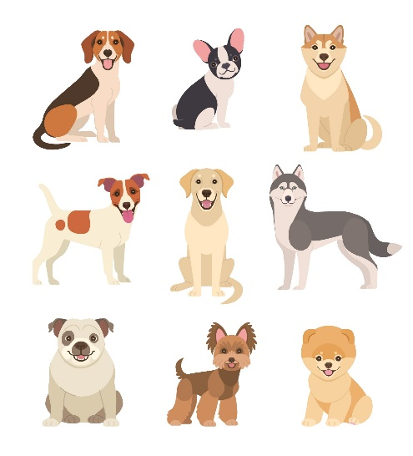
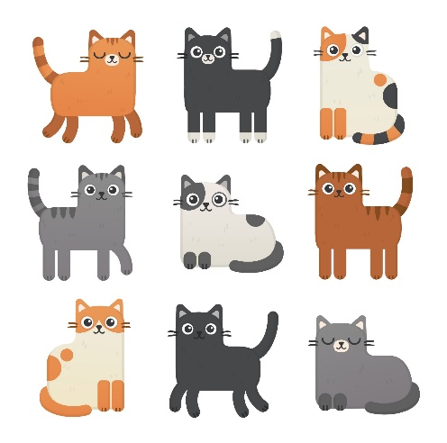
Supervised Learning vs Unsupervised Learning
Data
Clustering
Supervised Learning - discover patterns in the data that relate data attributes with a target (class) attribute.
These patterns are then utilized to predict the values of the target attribute in future data instances.
Unsupervised Learning - The data have no target attribute.
We want to explore the data to find some intrinsic structures or patterns in them that will allow us to cluster the data in related subsets.
Dog
Dog
Dog
Dog
Dog
Dog
Dog
Dog
Dog
Cat
Cat
Cat
Cat
Cat
Cat
Cat
Cat
Cat
ICT

Slide 4
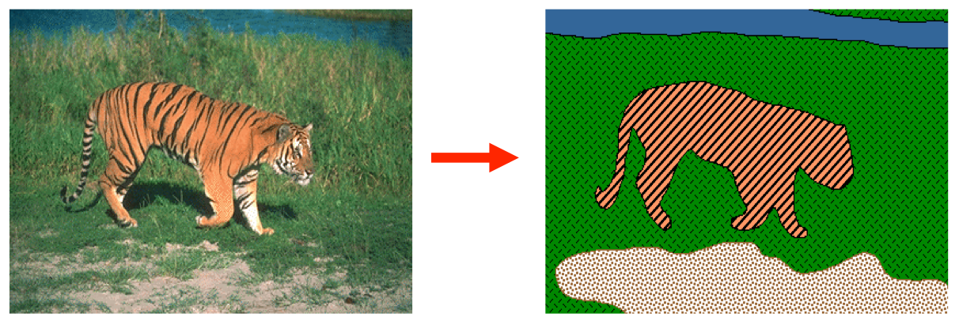
What is Clustering?
Data
Clustering
Given a collection of objects (characterized by feature vectors, or just a matrix of pair-wise similarities), detects the presence of distinct groups (clusters), and assign class labels to the members of each group.
ICT

Slide 5
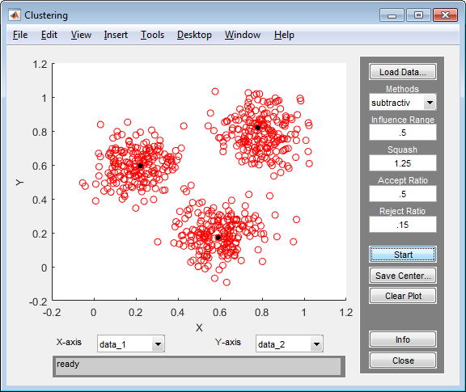
Clustering
Data
Clustering
Clustering is a technique for finding similarity groups in data, called clusters. I.e.,
It groups data instances that are similar to (near) each other in one cluster and data instances that are very different (far away) from each other into different clusters.
Clustering is often called an unsupervised learning task as no class values denoting an a priori grouping of the data instances are given, which is the case in supervised learning.
Due to historical reasons, clustering is often considered synonymous with unsupervised learning.
In fact, other techniques such as association rule mining and autoencoders are also unsupervised
ICT

Slide 6
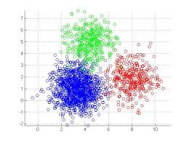
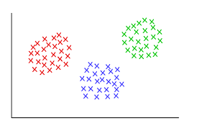
An Illustration of Clustering
Data
Clustering
These data sets have three natural groups of data points, i.e., 3 natural clusters.
ICT

Slide 7
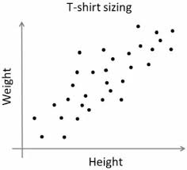
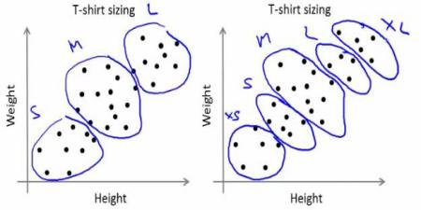
What is Clustering for?
Data
Clustering
Let us see some real-life examples:
Example 1 - groups people of similar sizes together to make “small”, “medium” and “large” T-Shirts.
Tailor-made for each person: too expensive
One-size-fits-all: does not fit all.
Example 2 - In marketing, segment customers according to their similarities.
To do targeted marketing.
ICT

Slide 8
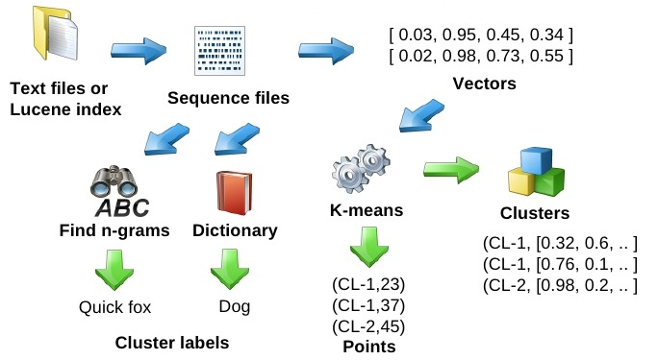
What is Clustering for?
Data
Clustering
Example 3 - Given a collection of text documents, we want to organize them according to their content similarities.
To produce a topic hierarchy.
In fact, clustering is one of the most utilized data mining techniques.
It has a long history, and used in almost every field, e.g., medicine, psychology, botany, sociology, biology, archeology, marketing, insurance, libraries, etc.
In recent years, due to the rapid increase of online documents, text clustering has become more important.
ICT

Slide 9
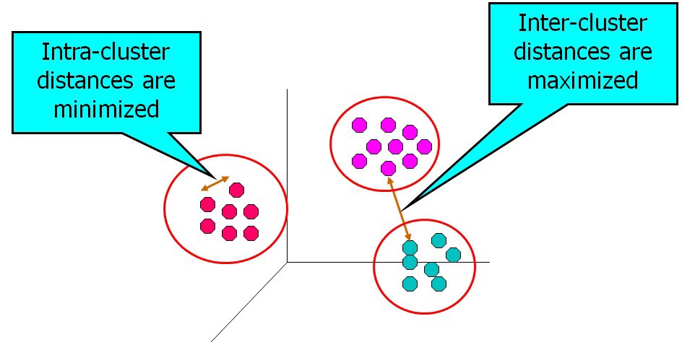
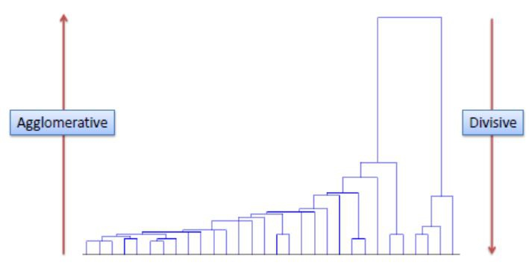
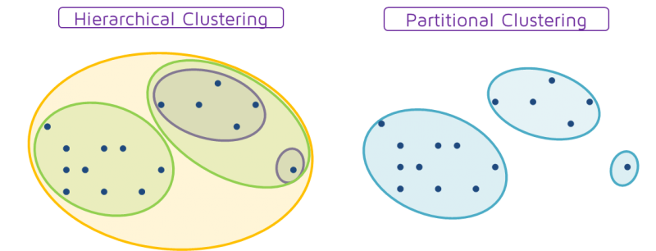
Aspects of Clustering
Data
Clustering
Types of clustering algorithms:
Partitional clustering
Hierarchical clustering
Agglomerative / Divisive
A distance (similarity, or dissimilarity) function.
Clustering quality:
Inter-clusters distance ⇒ maximized
Intra-clusters distance ⇒ minimized
The quality of the clustering result depends on the algorithm, the distance function, the input data, and the application.
ICT

Slide 10
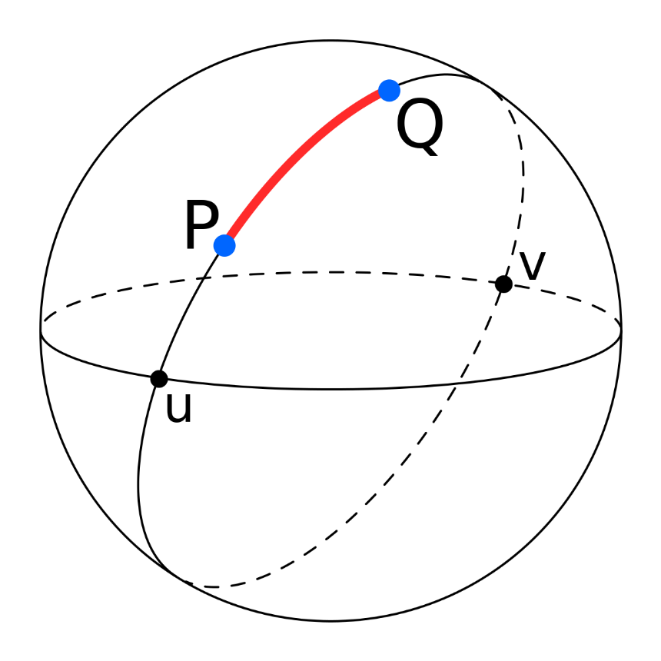
Distance Functions
Data
Clustering
M = (D,d)
Data domain D
Total (distance) function d: D × D → 
The function d is called the metric function, the metric, or distance function.
The metric space postulates:
Non-negativity
Symmetry
Identity
Triangle inequality
ICT

Slide 11
Is Clustering Well-defined?
Data
Clustering
“Clustering” is an ill-defined problem
There are many different clustering tasks possibly leading to different clustering paradigms:
ICT

Slide 12
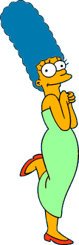




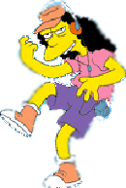



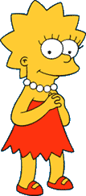
Clustering is Subjective!
Data
Clustering
Simpson's Family
School Employees
Females
Males
This label is unknown!
Clustering depends on a similarity (relational, but subjective, criterion) that will be expressed through a distance function.
Different people may cluster objects in a different way.
ICT

Slide 13
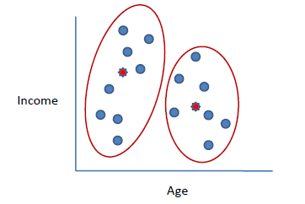
Roadmap
Data
Clustering
Basic Concepts
K-Means Algorithm
Representation of Clusters
Hierarchical Clustering
Distance Functions
Data Standardization
Handling Mixed Attributes
Which Clustering Algorithm to use?
Summary
K-Means
ICT

Slide 14
K-Means Clustering
Data
Clustering
K-means is a partitional clustering algorithm
Let the set of data points (or instances) D be
{x₁, x₂, …, x_{n}},
where x_{i} = (x_{i1}, x_{i2}, …, x_{ir}) is a vector in a real-valued vector space X ⊆ R^{r}, and r is the number of attributes (dimensions) in the data.
The k-Means algorithm partitions the given data into k clusters.
Each cluster has a cluster center, called centroid.
k is specified by the user .
ICT

Slide 15
K-Means Clustering
Data
Clustering
Given k, the k-Means algorithm works as follows:
Randomly choose k data points (seeds) to be the initial centroids, cluster centers.
Assign each data point to the closest centroid (given some distance function f.
Re-compute the centroids using the current cluster memberships.
If a convergence criterion is not met, go to 2).
Notes:
Distance function used is usually Euclidean distance.
The convergence criterion is usually the case when the centroids are recomputed, the data points are re-assigned a class, and no data point changes its previous class.
k is chosen by the user and is an input parameter.
You sometimes have to experiment with values of k.
ICT

Slide 16
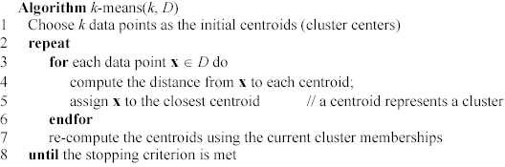
K-Means Pseudocode
Data
Clustering
ICT

Slide 17
Stopping/Convergence Criteria
Data
Clustering
no (or minimum) re-assignments of data points to different clusters,
no (or minimum) change of centroids, or
minimum decrease in the sum of squared error (SSE),
C_{i} is the jth cluster, m_{j} is the centroid of cluster C_{j} (the mean vector of all the data points in C_{j}), and dist(x, m_{j}) is the distance between data point x and centroid m_{j}.
(1)
ICT

Slide 18
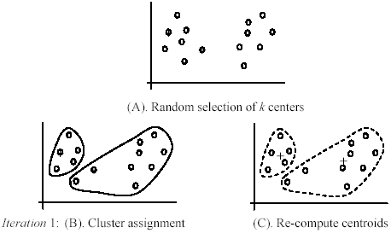
K-Means - An Example
Data
Clustering
+
+
ICT

Slide 19
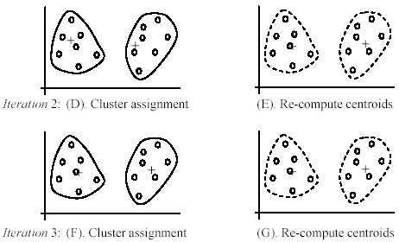
K-Means - An Example
Data
Clustering
ICT

Slide 20
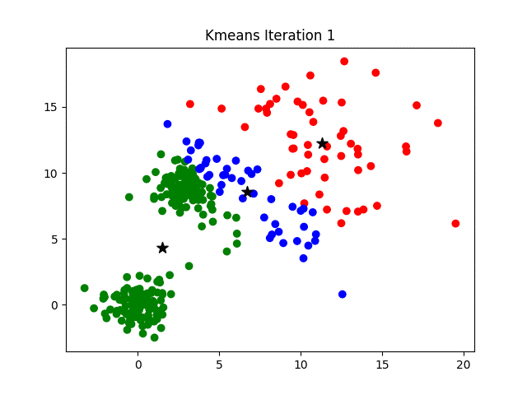
k-Means Animated
Data
Clustering
Even with non-optimal initial seeds, k-Means usually recovers and yields reasonably good clusters.
k-Means iteratively re-computes the cluster centroids and then re-assigns each of the data points.
From the animation, we can see that, at each iteration, the cluster centroids moving toward their final, optimal, locations.
Let’s run the animation.
ICT

Slide 21
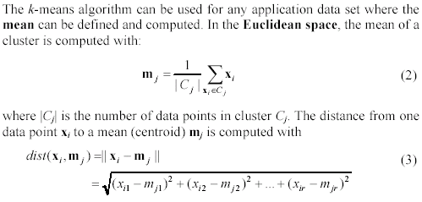
An Example of a Distance Function
Data
Clustering
ICT

Slide 22
A Disk Version of k-Means
Data
Clustering
k-Means can be implemented with the data points on disk
In each iteration, it scans the data once.
The centroids can be computed incrementally.
It can be used to cluster large datasets that do not fit in main memory.
We may need to control the number of iterations
In practice, the limit is set (< 50).
Not really the best method. There are other, better, scale-up algorithms, e.g., BIRCH.
ICT

Slide 23
Strengths of k-Means
Data
Clustering
Strengths:
Simple: easy to understand and to implement
Efficient: Time complexity: O(tkn),
where n is the number of data points,
k is the number of clusters, and
t is the number of iterations.
Since both k and t are small. k-Means is considered a linear algorithm.
k-Means is the most popular clustering algorithm.
Note that: it terminates at a local optimum if SSE is used. The global optimum is hard to find due to the required computational complexity.
ICT

Slide 24
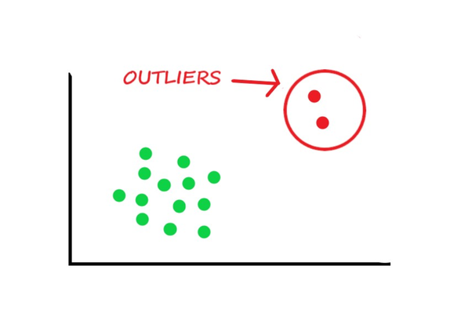
Weaknesses of k-Means
Data
Clustering
The algorithm is only applicable if the mean is defined.
For categorical data, k-mode - the centroid is represented by most frequent values.
The user needs to specify k.
The algorithm is sensitive to outliers.
Outliers are data points that are very far away from other data points.
Outliers could be errors in the data collection or some special data points with very different values.
ICT

Slide 25
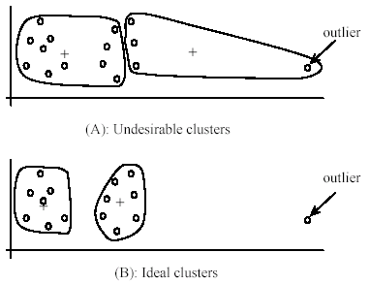
Weaknesses of k-Means - Problems with Outliers
Data
Clustering
ICT

Slide 26
Weaknesses of k-Means - Dealing with Outliers
Data
Clustering
One method is to remove some data points in the clustering process that are much further away from the centroids than other data points.
To be safe, we may want to monitor these possible outliers over a few iterations and then decide to remove them.
Another method is to perform random sampling. Since in sampling we only choose a small subset of the data points, the chance of selecting an outlier is small.
Assign the rest of the data points to the clusters by distance or similarity comparison, or classification.
ICT

Slide 27
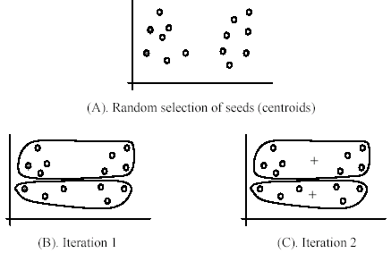
Weaknesses of k-means (cont …)
Data
Clustering
The algorithm may be sensitive to initial seeds.
ICT

Slide 28
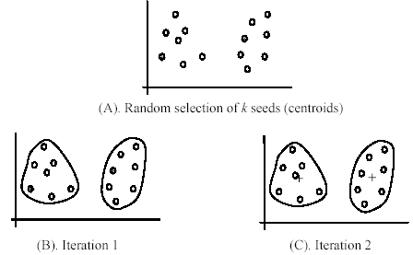
Weaknesses of k-Means (cont …)
Data
Clustering
If we use different seeds we get good results.
There are some good statistical methods to help select good seeds.
ICT

Slide 29
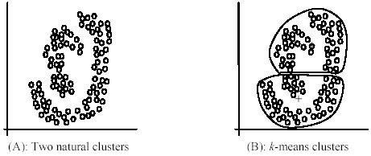
Weaknesses of k-Means (cont …)
Data
Clustering
The k-Means algorithm is not suitable for discovering clusters that are not hyper-ellipsoids (or hyper-spheres).
+
ICT

Slide 30
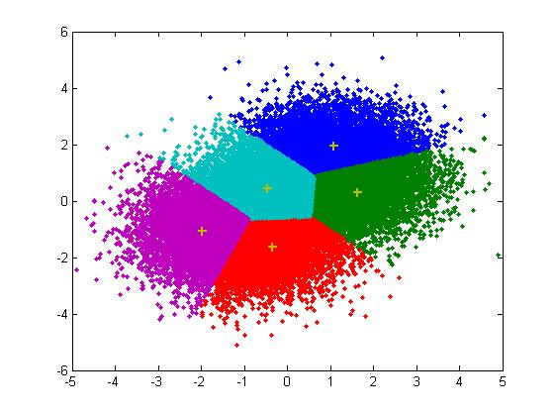
K-Means – A Summary
Data
Clustering
Despite weaknesses, k-Means is still the most popular algorithm due to its simplicity, efficiency and ubiquity.
Other clustering algorithms have their own lists of weaknesses.
There is no clear evidence that any other clustering algorithm performs better, in general.
Although some may be more suitable for some specific types of data or applications.
Comparing different clustering algorithms is a difficult task. No one knows what the correct clusters are!
ICT

Slide 31
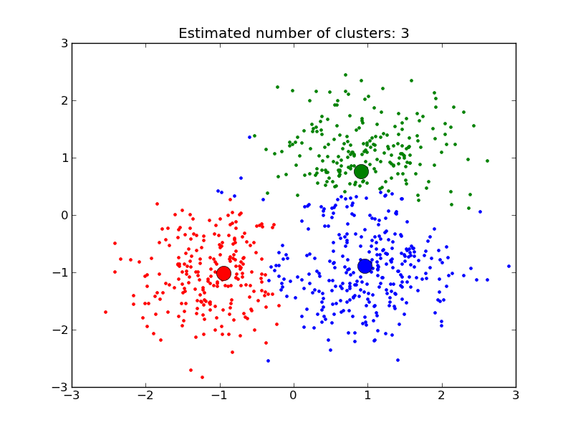
Roadmap
Data
Clustering
Basic Concepts
K-Means Algorithm
Representation of Clusters
Hierarchical Clustering
Distance Functions
Data Standardization
Handling Mixed Attributes
Which Clustering Algorithm to use?
Summary
ICT

Slide 32
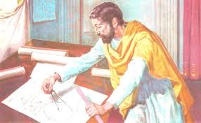
Common Way to Represent Clusters
Data
Clustering
Use the centroid of each cluster to represent the cluster.
Compute the radius, and,
Standard deviation of the cluster to determine its spread in each dimension.
The centroid representation alone works well if the clusters are of the hyper-spherical shape and Euclidean distance.
If clusters are elongated or are of other shapes, centroids are not sufficient.
ICT

Slide 33
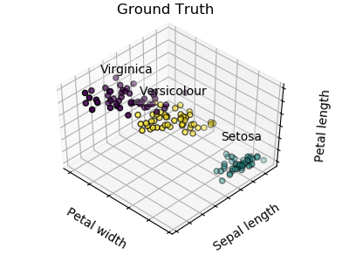
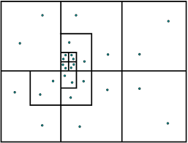
Common Way to Represent Clusters
Data
Clustering
Quad-Tree Representation
ICT

Slide 34
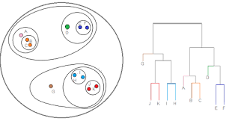
Roadmap
Data
Clustering
Basic Concepts
K-Means Algorithm
Representation of Clusters
Hierarchical Clustering
Distance Functions
Data Standardization
Handling Mixed Attributes
Which Clustering Algorithm to use?
Summary
ICT

Slide 35
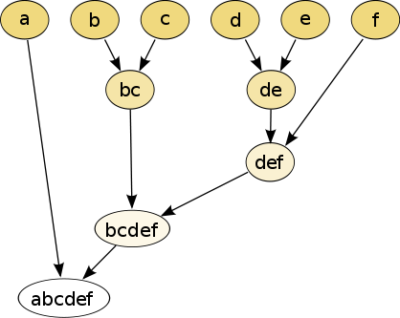
Hierarchical Clustering
Data
Clustering
Produces a nested sequence of clusters, a tree, also called Dendrogram.
ICT

Slide 36
Types of Hierarchical Clustering
Data
Clustering
Agglomerative (bottom up) clustering: It builds the dendrogram (tree) from the bottom level, and
merges the most similar (or nearest) pair of clusters.
Stops when all the data points are merged into a single cluster (i.e., the root cluster).
Divisive (top down) clustering: It starts with all data points in one cluster, the root.
Splits the root into a set of child clusters. Each child cluster is recursively divided further .
Stops when only singleton clusters of individual data points remain, i.e., each cluster with only a single point.
ICT

Slide 37
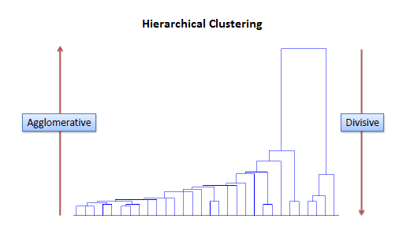
Types of Hierarchical Clustering
Data
Clustering
ICT

Slide 38
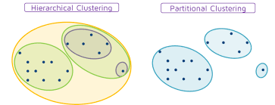
Hierarchical vs Partitional
Data
Clustering
ICT

Slide 39
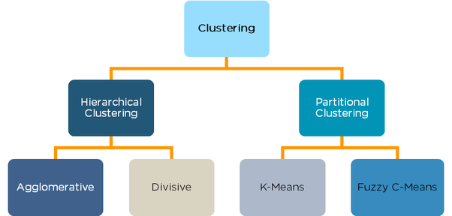
Hierarchical vs Partitional
Data
Clustering
ICT

Slide 40
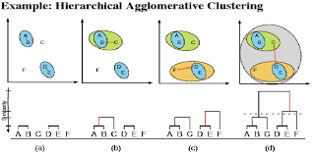
Agglomerative Clustering
Data
Clustering
More popular then divisive methods.
At the beginning, each data point forms a cluster (also called a node).
Merge nodes/clusters that have the least distance (i.e. the closest).
Go on merging…
Until eventually all nodes belong to one cluster.
ICT

Slide 41
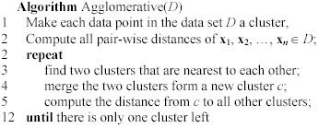
Agglomerative Clustering Algorithm
Data
Clustering
ICT

Slide 42
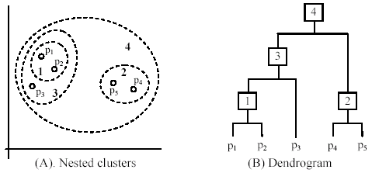
An example of Agglomerative Clustering
Data
Clustering
ICT

Slide 43
Measuring the Distance between Two Clusters
Data
Clustering
There are many ways to measure the distance between two clusters.
Results in different variations of the algorithm.
Single link.
Complete link.
Average link.
Centroids.
…
ICT

Slide 44
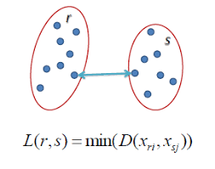
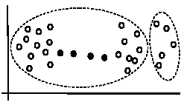
Single-Linkage Method
Data
Clustering
Also known as the Minimum or Nearest Neighbour method.
The distance between two clusters is the distance between two closest data points in the two clusters, one data point from each cluster.
It can find arbitrarily shaped clusters, but
It may cause the undesirable “chain effect” by noisy points.
Two natural clusters are split into two
ICT

Slide 45
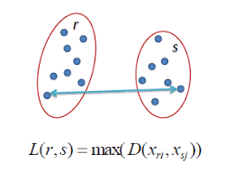
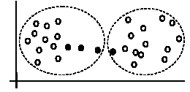
Complete-Linkage Method
Data
Clustering
Also know as the Maximum or the Farthest Neighbour method.
The distance between two clusters is the distance of two furthest data points in the two clusters.
It is sensitive to outliers because they are far away.
ICT

Slide 46
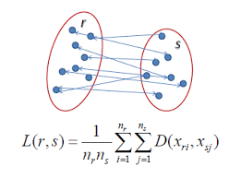
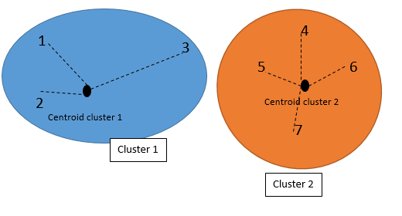
Average-Linkage and Centroid Methods
Data
Clustering
Average-Linkage - A compromise between;
The sensitivity of complete-link clustering to outliers and;
the tendency of single-link clustering to form long chains that do not correspond to the intuitive notion of clusters as compact, spherical objects.
In this method, the distance between two clusters is the average distance of all pair-wise distances between the data points in two clusters.
Centroid Method - In this method, the distance between two clusters is the distance between their centroids.
ICT

Slide 47
Time Complexity
Data
Clustering
All the algorithms are at least O(n²) where n is the number of data points.
Single link can be done in O(n²).
Complete and average links can be done in O(n²log₂n).
Due the complexity, not feasible for large data sets.
Sampling.
Scale-up methods (e.g., BIRCH).
ICT

Slide 48

Summary of Linkage Clustering Methods
Data
Clustering
©Victor Lavenko

Slide 49
Some Notes
Data
Clustering
The Single-Linkage algorithm allows clusters to grow long and thin whereas the Complete-Linkage algorithm produces, in general, more compact clusters.
Both algorithms are susceptible to outliers or by deviant observations.
The Average-Linkage is an attempt to compromise between the extremes of Single or Complete Linkage methods.
The Average-Linkage algorithm is also known as the Unweighted Pair-Group Method using Arithmetic Averages (UPGMA) and is probably the most widely used hierarchical method.
ICT

Slide 50

Roadmap
Data
Clustering
Basic Concepts
K-Means Algorithm
Representation of Clusters
Hierarchical Clustering
Distance Functions
Data Standardization
Handling Mixed Attributes
Which Clustering Algorithm to use?
Summary
ICT

Slide 51
Distance Functions
Data
Clustering
The choice, or selection, of the distance function is of key importance in clustering.
This is because clustering is directly based on the distance of data items to each other.
Note that “similarity” and “dissimilarity” can also commonly used terms.
There are numerous distance functions (metrics) for
Different types of data:
Numeric data.
Nominal / Categorical data.
Different specific applications.
ICT

Slide 52
Distance Functions for Numeric attributes
Data
Clustering
Most commonly used functions are:
Euclidean distance and
Manhattan (city block) distance
We denote distance with: dist(x_{i}, x_{j}), where x_{i} and x_{j} are data points (vectors)
They are special cases of Minkowski distance. h is a positive integer.
ICT

Slide 53
Euclidean and Manhattan Distance
Data
Clustering
If h = 2, it is the Euclidean distance
If h = 1, it is the Manhattan distance
Weighted Euclidean distance
ICT

Slide 54
Squared Distance and Chebychev Distance
Data
Clustering
Squared Euclidean distance: to place progressively greater weight on data points that are further apart.
Chebychev distance: one wants to define two data points as "different" if they are different on any one of the attributes.
ICT

Slide 55

Distance Function for Text Documents
Data
Clustering
A text document consists of a sequence of sentences and each sentence consists of a sequence of words.
To simplify: a document is usually considered a “bag” of words in document clustering.
Sequence and position of words are ignored.
A document is represented with a vector just like a normal data point.
It is common to use similarity to compare two documents rather than distance.
The most commonly used similarity function is the cosine similarity. We will study this later.
ICT

Slide 56

Roadmap
Data
Clustering
Basic Concepts
K-Means Algorithm
Representation of Clusters
Hierarchical Clustering
Distance Functions
Data Standardization
Handling Mixed Attributes
Which Clustering Algorithm to use?
Summary
ICT

Slide 57
Data Standardization
Data
Clustering
In the Euclidean space, standardization of attributes may be required so that all attributes can have equal impact on the computation of distances.
Consider the following pair of data points
x_{i}: (0.1, 20) and x_{j}: (0.9, 720).
The distance is almost completely dominated by (720-20) = 700.
Standardize attributes - to force the attributes to have a common value range.
Sometimes called normalization or scaling.
ICT

Slide 58

Roadmap
Data
Clustering
Basic Concepts
K-Means Algorithm
Representation of Clusters
Hierarchical Clustering
Distance Functions
Data Standardization
Handling Mixed Attributes
Which Clustering Algorithm to use?
Summary
ICT

Slide 59

Roadmap
Data
Clustering
Basic Concepts
K-Means Algorithm
Representation of Clusters
Hierarchical Clustering
Distance Functions
Data Standardization
Handling Mixed Attributes
Which Clustering Algorithm to use?
Summary
ICT

Slide 60
How to Choose a Clustering Algorithm
Data
Clustering
Clustering research has a long history. A vast collection of algorithms are available.
We only introduced several main algorithms.
Choosing the “best” algorithm is a challenge.
Every algorithm has limitations and works well with certain data distributions.
It is very hard, if not impossible, to know what distribution the application data follow. The data may not fully follow any “ideal” structure or distribution required by the algorithms.
One also needs to decide how to standardize the data, to choose a suitable distance function and to select other parameter values.
ICT

Slide 61
Choosing a Clustering Algorithm (cont …)
Data
Clustering
Due to these complexities, the common practice is to:
run several algorithms using different distance functions and parameter settings, and
then carefully analyze and compare the results.
The interpretation of the results must be based on insight into the meaning of the original data together with knowledge of the algorithms used.
Clustering is highly application dependent and to certain extent subjective (personal preferences).
ICT

Slide 62

Roadmap
Data
Clustering
Basic Concepts
K-Means Algorithm
Representation of Clusters
Hierarchical Clustering
Distance Functions
Data Standardization
Handling Mixed Attributes
Which Clustering Algorithm to use?
Summary
ICT

Slide 63
Summary
Data
Clustering
Clustering is has a long history and still active researched
There are a huge number of clustering algorithms.
More are still coming every year.
We only introduced a few of the several main algorithms. There are many others, e.g.,
density based algorithm, sub-space clustering, scale-up methods, neural networks based methods, fuzzy clustering, co-clustering, etc.
Clustering is hard to evaluate, but very useful in practice. This partially explains why there are still a large number of clustering algorithms being devised every year.
Clustering is highly application dependent and to some extent subjective.
The choice of distance function is critically important.
K-Means is probably the most popular general purpose clustering algorithm.
ICT

